Slide 1
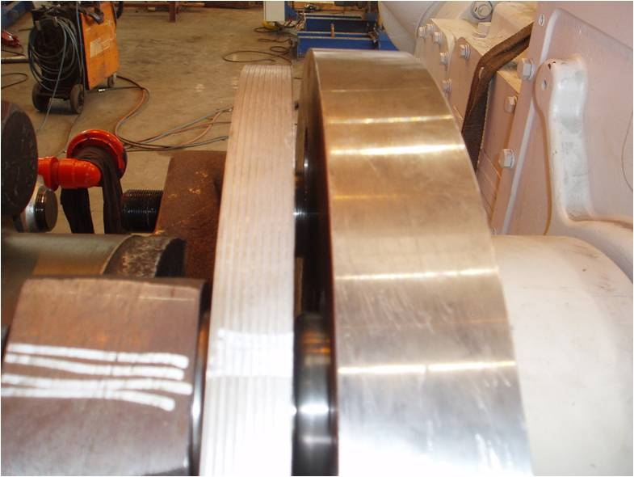
HS&E INCIDENT BULLETIN |  | 3rd Quarter 2012
Type of Incident | Hand Contact with Objects/Equipment
Summary:
While working with a coupling shim pack, a field service employee suffered a cut on his finger which required stitching. Upon return to his home country, the IP went to his local doctor who said that the treatment provided had been incorrect and that there may have been tendon damage. IP was prescribed DAFW to recover.
Root Causes: | Actions Taken Thus Far: Next Steps
IP’s hand was within the hazard zone when the coupling dropped, and he was not wearing any suitable hand protection. Coupling connector pin had been removed by another mechanic. Both employees were not able to communicate safety aspects of the connector pin sufficiently due to language barriers. No Job Hazard Analysis (JHA) performed prior to beginning work to identify potential dropped object. | Reinforce the IP's awareness of body positioning when manipulating parts of components that have the ability to fall. IP advised of the need to obtain and wear suitable PPE for the job being carried out. Awareness of IP to be raised to carry out a JHA before tasks in order to identify hazards and the key protective devices and establish suitable controls. IP made aware of the need to ensure that arrangements are put in place so that safety critical aspects of the job are communicated effectively despite potential language barriers.
Shim pack that fell

